Slide 1
Final Project: Data Analysis of Employee Attrition
Presenter:
Ziyang Guo

Slide 2
1. Introduction:
This project aims to uncover the factors that lead to employee attrition and explore important questions. Attrition is a problem that impacts all businesses, irrespective of geography, industry, and size of the company. Employee attrition leads to significant costs for a business, including the cost of business disruption, hiring new staff, and training new staff. I will use the IBM dataset to try to figure out the top five factors' lead to attrition. At last I am also going to find out how has it changed over this 4 years.

Slide 3
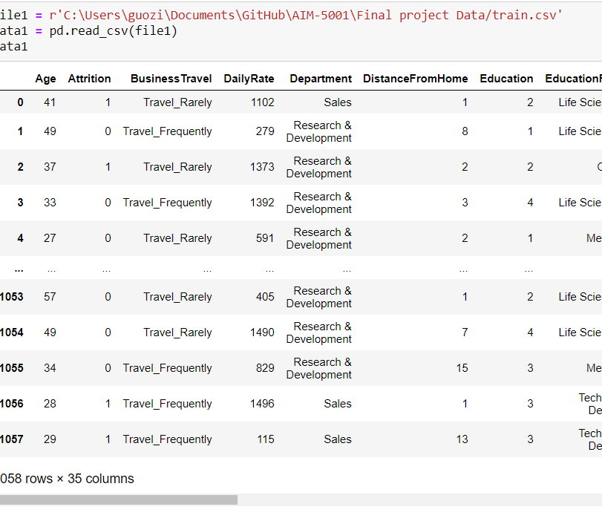
2.Data Summary
I choose 2 datasets from Kaggle. One of them is IBM employees sample in 2020.The other one is the IBM employees sample in 2016. These 2 datasets include similar contents. I downloaded the first dataset and turn it into pandas DataFrame.

Slide 4
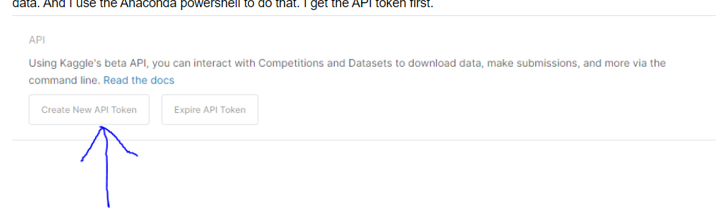
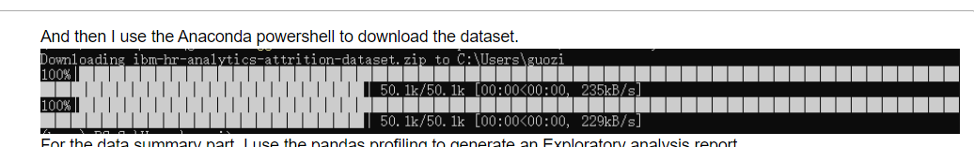
2.Data Summary
For the second dataset, I used the Kaggle API to get the data.

Slide 5
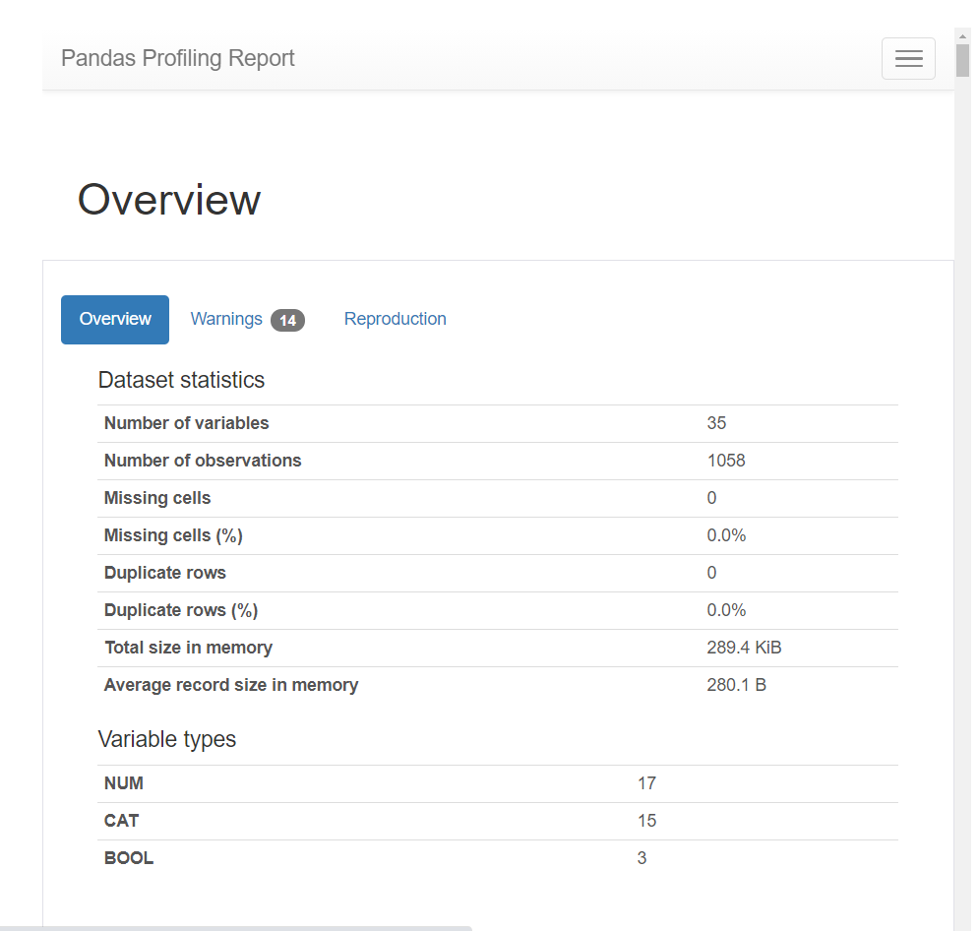
3.EDAs& Approaches
First:
Notes:
First, I used the pandas-profiling.profilereport() to generate an well-organized profile report. And Base on this I started my EDA.

Slide 6
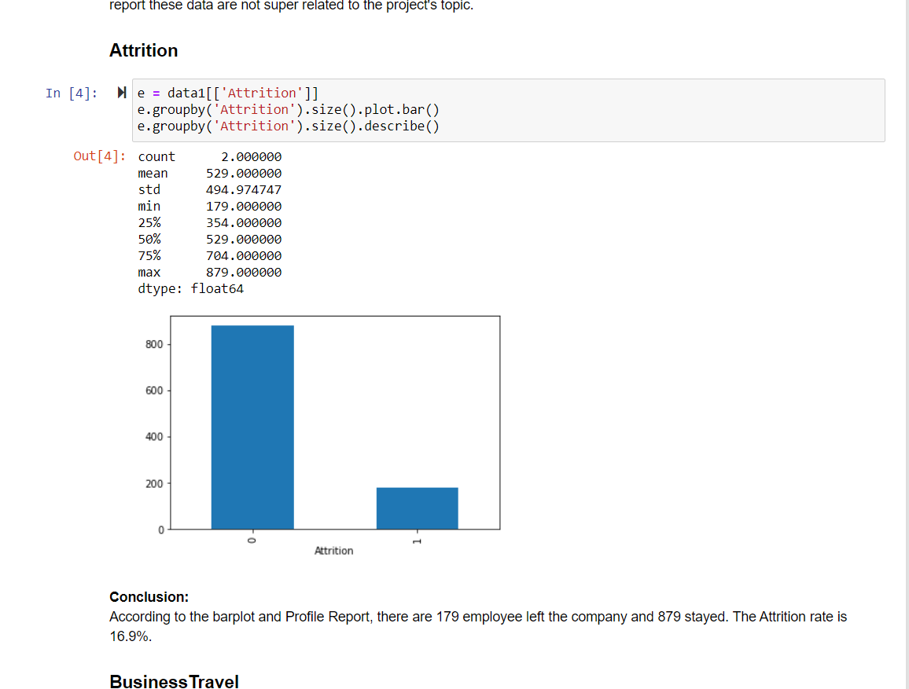
3.EDAs& Approaches
Then I just do the exploratory analysis for most of the columns in the dataset.

Slide 7
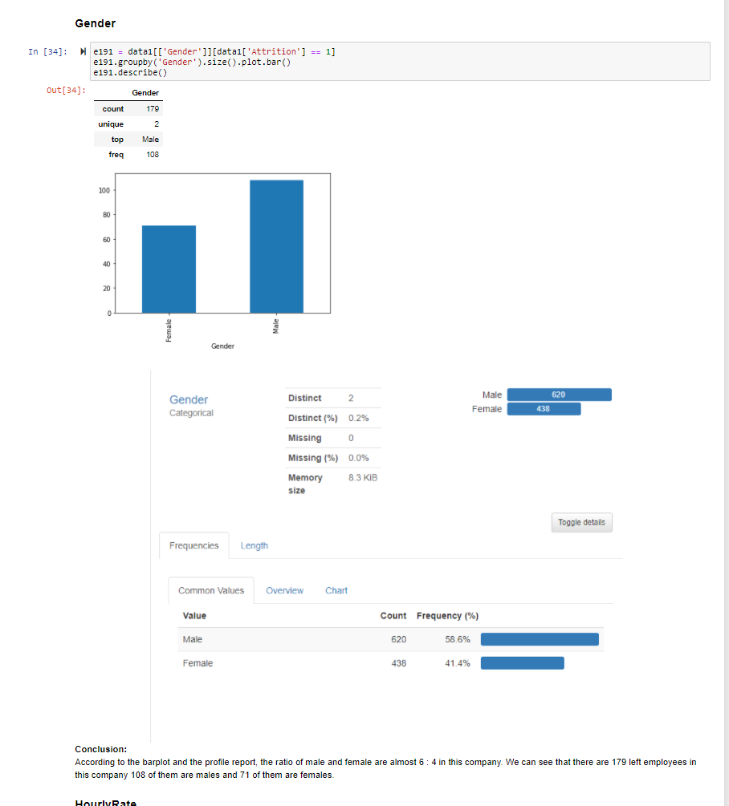
3.EDAs& Approaches

Slide 8
EDAs& Approaches
After the EDAs, I get a conclusion that the employee attrition could be caused by multiple factors.
My Research questions may help to find out those factors.

Slide 9
Research questions
Q1: What's the rate of the employees that have 'yearsAtCompany' more than 5 years?
Q2: What's the rate of the employees that have 'education' higher than 2 and 'YearsAtCompany' over than5?
Q3 What's the rate of those attrition employees whose 'MaritalStatus' are single?
Q4 what's the rate of those attrition employees whose 'EnvironmentSatisfaction' are lower than 3?
Q5 What's the difference of these 4 rates in 2016 and 2020?

Slide 10
Research questions
Q1: What's the rate of the employees that have 'yearsAtCompany' more than 5 years?
63.2%
Q2: What's the rate of the employees that have 'education' higher than 2 and 'YearsAtCompany' over than5?
53.78%
Q3 What's the rate of those attrition employees whose 'MaritalStatus' are single?
52.51%
Q4 what's the rate of those attrition employees whose 'EnvironmentSatisfaction' are lower than 3?
77.65%

Slide 11
Research questions
Q5 What's the difference of these 4 rates in 2016 and 2020?
In Q5 I just use the second data which is the IBM employee sample in 2016. I turn the data in to pandas.DataFrame.

Slide 12
Research questions:
Comparing the 2020's analysis and 2016's analysis, we can see that the rate of the employees that have 'YearsAtCompany' more than 5 years increased 7.7%. That mean there are more employees who choose to stay longer in this company. And the rate of employees with education level higher than college and stayed in this company more than 5 years decreased about 2%. That means the education level structure in this company are really stable. The rate of the attrition employees who are single increased 2%. And the rate of those trrition employees' environment satisfaction increased 3%. According to these 2 changes, we can see that in these 4 years people's happiness in life and work is increasing.

Slide 13
Difficulties
I did a lot of research on how to use the Kaggle API.
And When I wrote my proposal I didn’t even know what is Pandas_profiling. I also spent 2-3 hours on learning how to use it and how to interpret it.

Slide 14
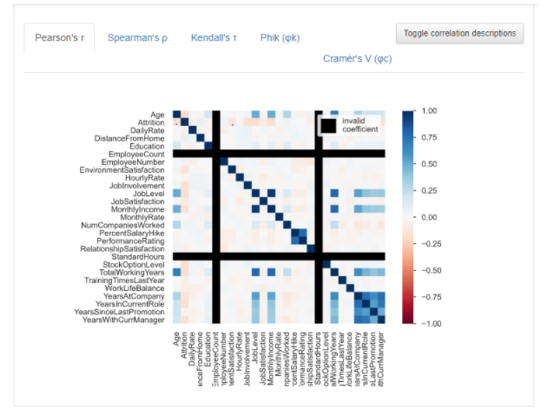
Conclusion:

Slide 15
Conclusion:
The Pearson's correlation coefficient (r) is a measure of linear correlation between two variables. It's value lies between -1 and +1, -1 indicating total negative linear correlation, 0 indicating no linear correlation and 1 indicating total positive linear correlation. Furthermore, r is invariant under separate changes in location and scale of the two variables, implying that for a linear function the angle to the x-axis does not affect r. According to the Pearson's correlation plot, we can know that The Age, Environment satisfaction, Job involvement, Monthly income, Stok option level, Total Working years, Years at company, Years in current role, and Years with current manager are positive related to the attrition. The top 5 of them are Job level, Job involvement, Monthly income, Stock option level, and Year's in current role. In conclusion we can say that after these analysis above we finally figure out the top 5 factors that can lead to employee quiting a company.

Slide 16
Thank you for listening

